Slide 1
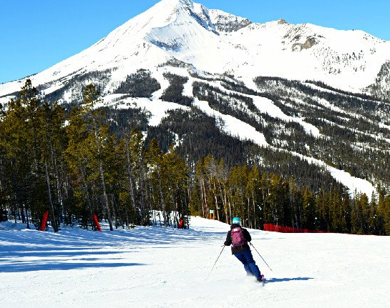
Big Mountain Resorts
Pizon Shetu

Slide 2
The Problem
Big Mountain Resorts needs to increase net-profits via increasing ticket prices or reducing operating costs.
Evaluate total facilities and other offerings to make adjustments that will cut costs or validate increase in revenue.
Make recommendation based on our findings.

Slide 3
Findings
Blue Mountain Resorts is under-charging for its ticket prices compared to its competitors given their offerings and venue.
They are charging Adult tickets at $81 according to our predictive model they could be charging around $95.87, even with a deviation of $10 they are still below what they can be charging.
They might also see an increase in revenue by the increase of runs and vertical drop

Slide 4
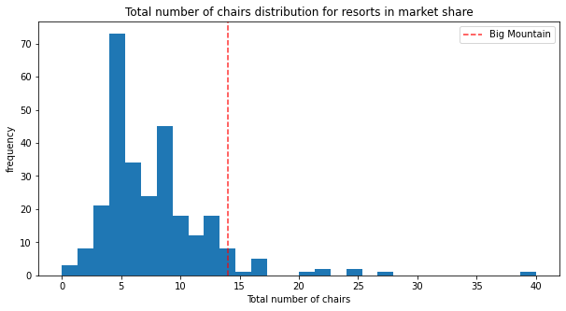
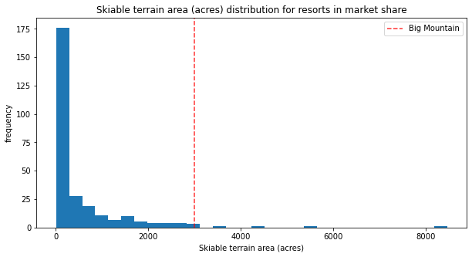
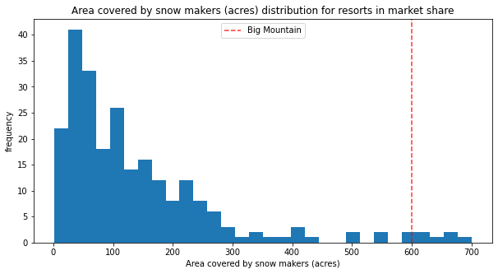
Analysis
According to our analysis the following features has the most impact on ticket price: Snow making area, Total Chairs, Skiable Terrain Area, Fast Quads, Runs, Longest Runs, Trams, and Total Skiable Area.
Big Mountain falls in the upper echelon of most of these features yet their competition with similar offerings charge a much higher premium

Slide 5
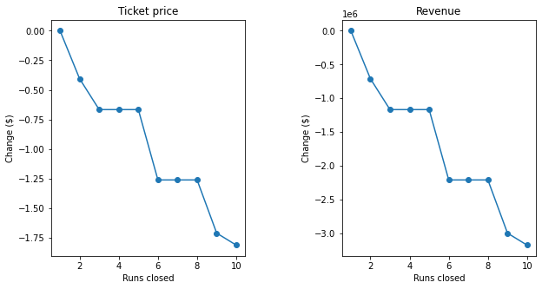
Analysis
Our model showed that Big Mountain may be able to leverage more savings by closing some runs, but revenue might decline once too many runs have been closed. It seems closing 4-6 runs and more had an impact on revenue but less than 4 saw no significant impact on revenue.

Slide 6
Recommendation
Big Mountain should seek to increase the vertical drop and the number of runs in their facility while this might require the installment of additional chair, we see a estimated revenue increase of $3.4 million
The costs of operating and installing a new chair is $1.54 million but this is still leave’s us net-positive overall netting a $1.86 million profit.
Further examining might be needed as the cost of increasing runs and vertical drops are not factored in.
Big Mountain could also close runs to cut costs without impacting prices significantly.

